Slide 1
Applying TLA+ in cloud systems
Dharma Shukla (@dharmashukla), Technical Fellow, Microsoft

Slide 2
Outline
A couple of systems
TLA+ in engineering teams
Conclusion

Slide 3
1. A couple of systems

Slide 4

Azure Cosmos database
Started in 2010 as Project Florence
Generally available since 2017
Ring-0, foundational Azure service, operating in all Azure regions, serving 10s of trillions requests/day
Became ubiquitous inside Microsoft and is one of the fastest growing Azure services

Slide 5
Design goals
Elastically scale throughput on-demand across any number of Azure regions around the world, within 5s at the 99th percentile
Deliver <10ms end-to-end client-server read/write latencies at the 99th percentile, in any Azure region
Oﬀer 99.999% read/write high availability
Provide tunable consistency models for developers
Operate at a very low cost
Provide strict performance isolation between transactional and analytical workloads
Build schema-agnostic engine to support unbounded schema versioning
Support multiple data models, and multiple popular OSS database APIs all operating on the same underlying data

Slide 6
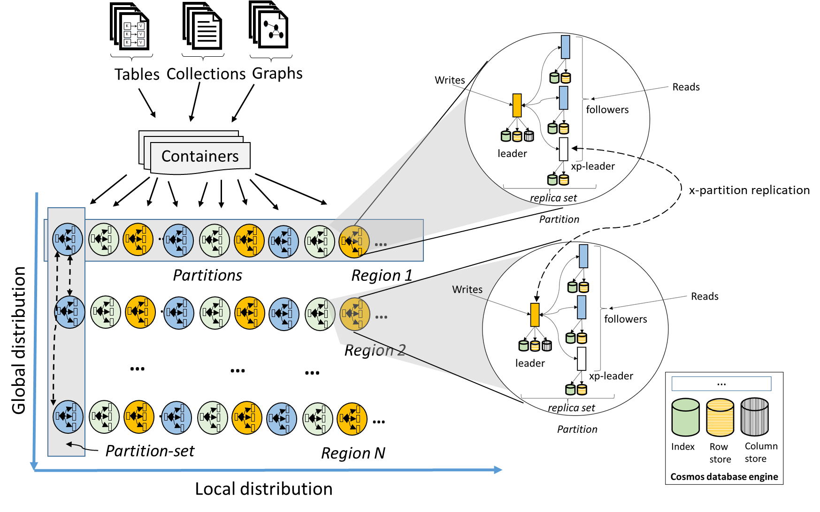
System model
Partition is a workhorse abstraction used as a highly available, resource-governed, reusable building block to solve various coordination problems in the system. E.g.
Global replication
Inter-cluster partition load balancing
Management operations including split, merge, clone
On-demand streaming
Nested consensus
Dynamically self-adjusting membership and quorums
Built-in resource governance
Tenants

Slide 7
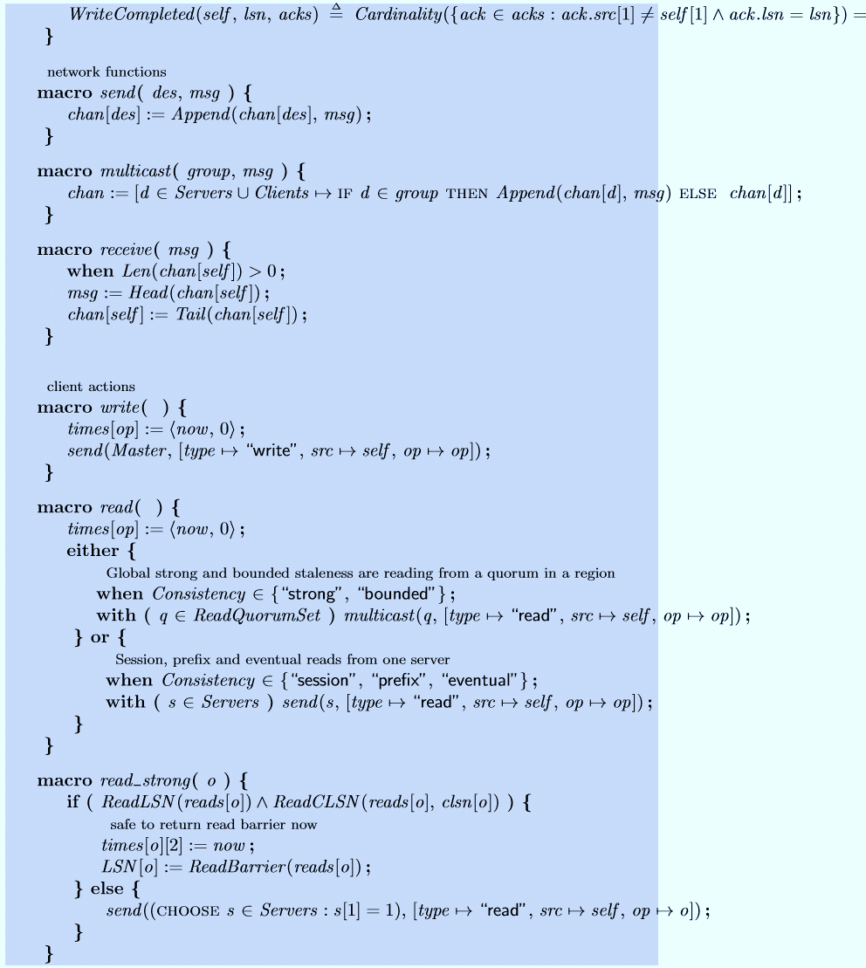
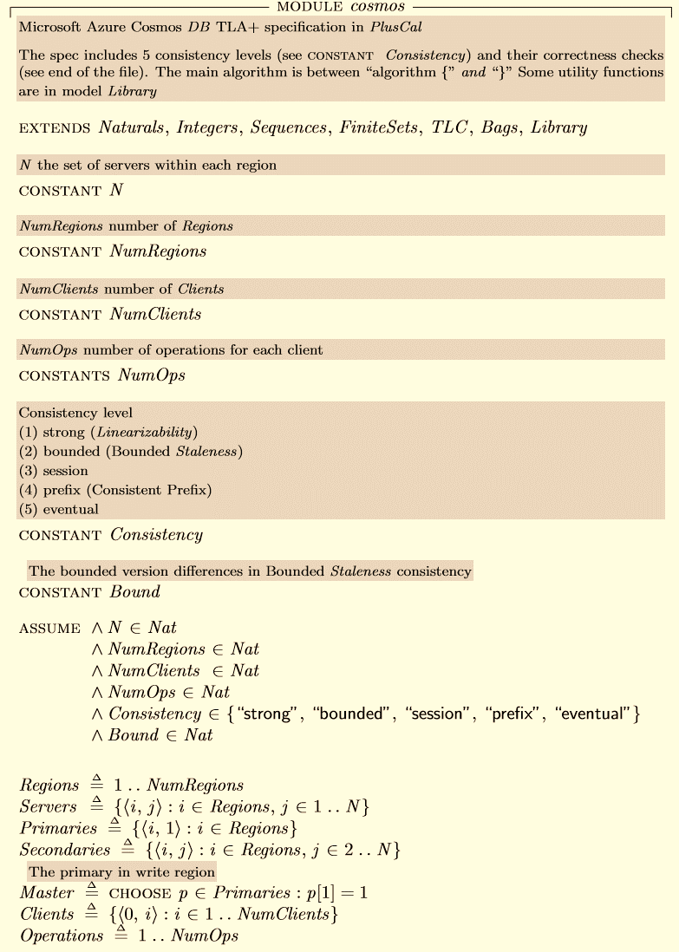
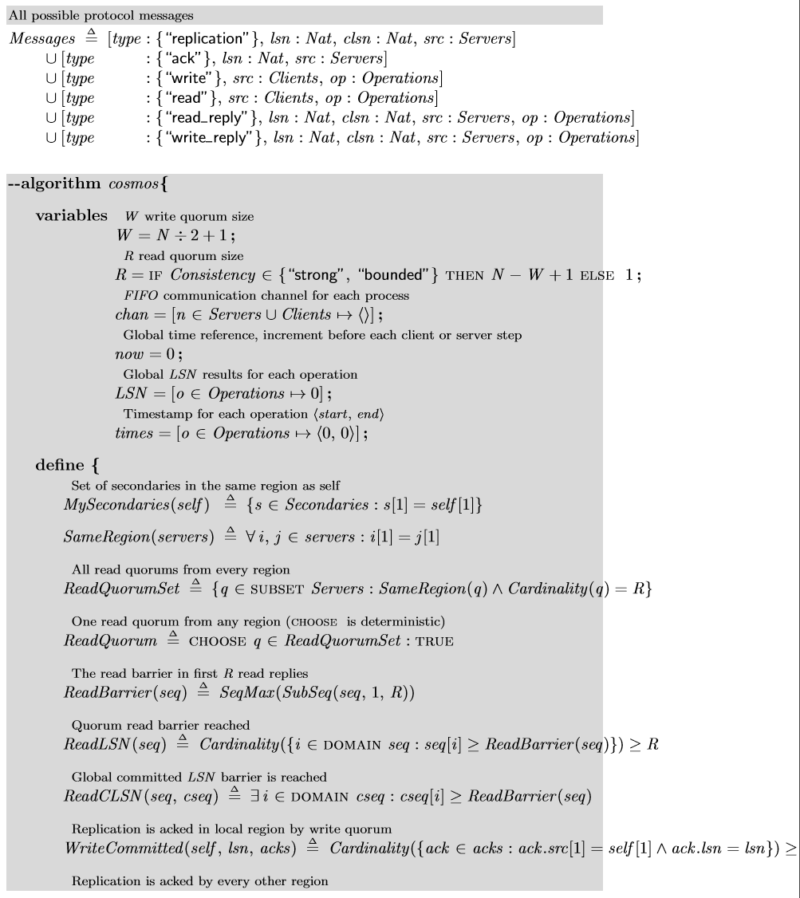
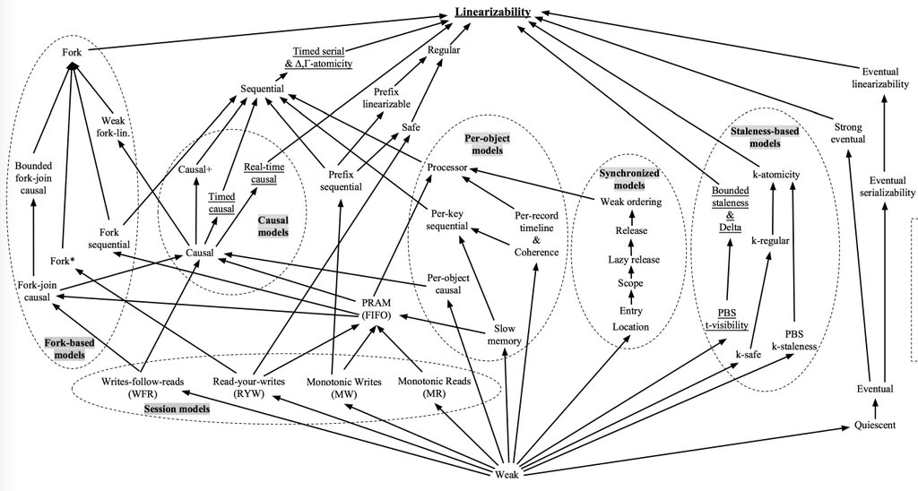
Precisely defined consistency levels with TLA+
Strong
Bounded-staleness
Session
Consistent-prefix
Eventual

Slide 8
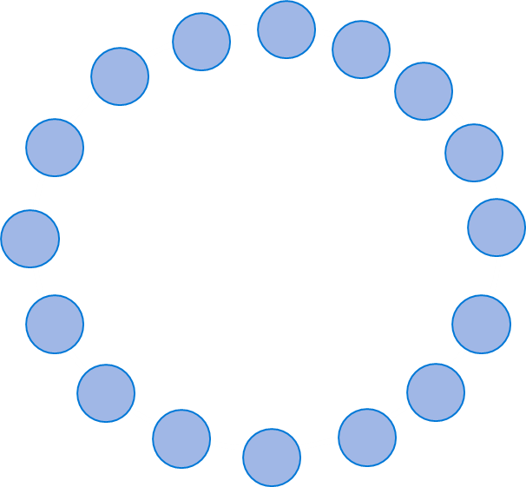


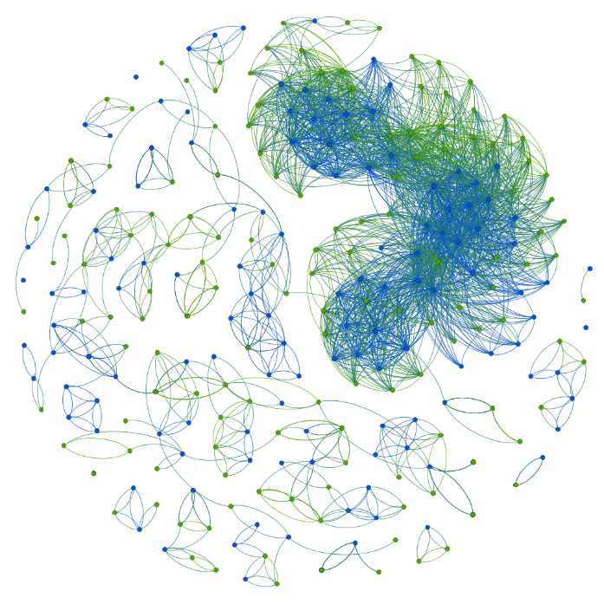
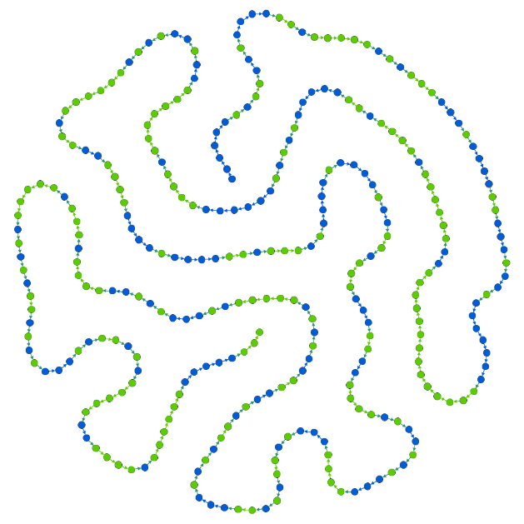
Continuous consistency checking over live data
Customer
Requests
Request logs
Consistency
metrics
Metrics DB
Azure Portal
Cosmos Cluster
Consistency Checker Service
Observed consistency is reported to customers along with the Probability Bounded Staleness (PBS) metric
Blue vertices -> Writes
Green vertices -> Reads
Dependency graph of operations
Linearizable History

Slide 9
Singularity
A globally distributed AI system that efficiently schedules resources
Transparent preemption of long running programs

Slide 10
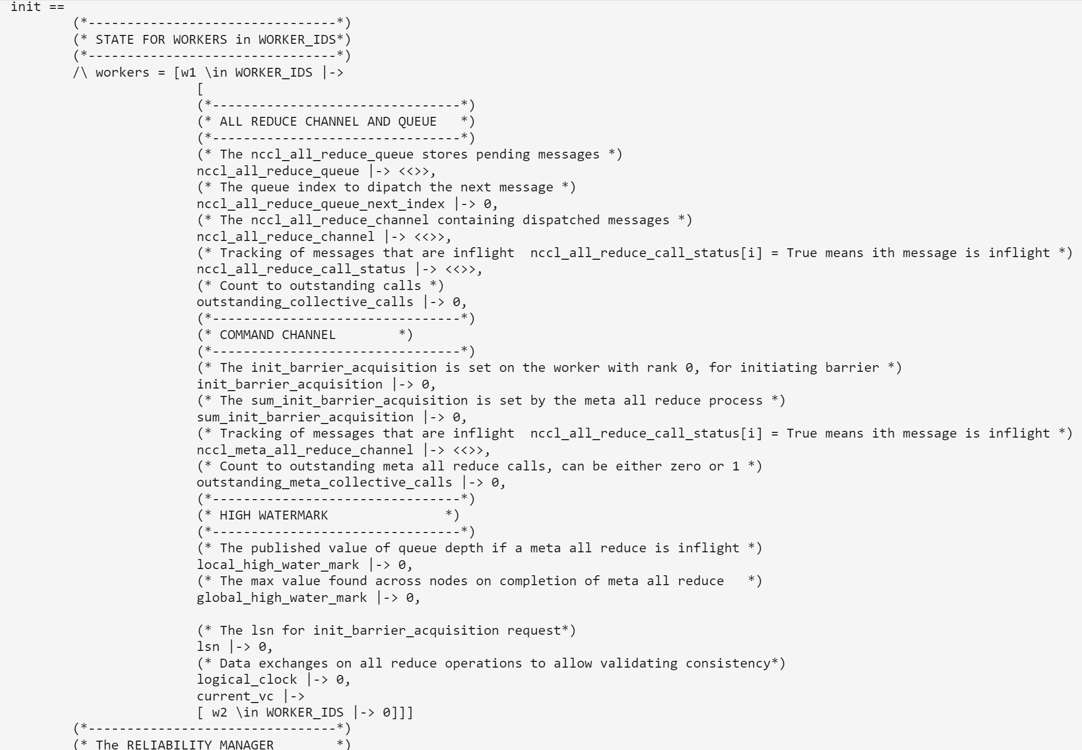
Consistent snapshotting at scale
Wrote the TLA+ specs for three different protocols
Tandem Collective algorithm
Queued Collective algorithm
Chandy-Lamport algorithm
TLA+ helped us evaluate the difficulty of implementing and efficiency tradeoffs
TLA+ enabled precise communication of the design across multiple teams

Slide 11
2. TLA+ in engineering teams

Slide 12
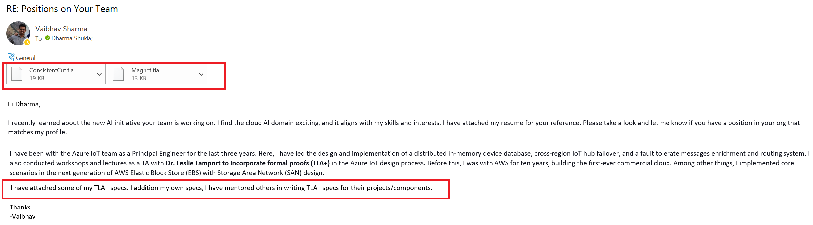
Hiring engineers with TLA+ background

Slide 13
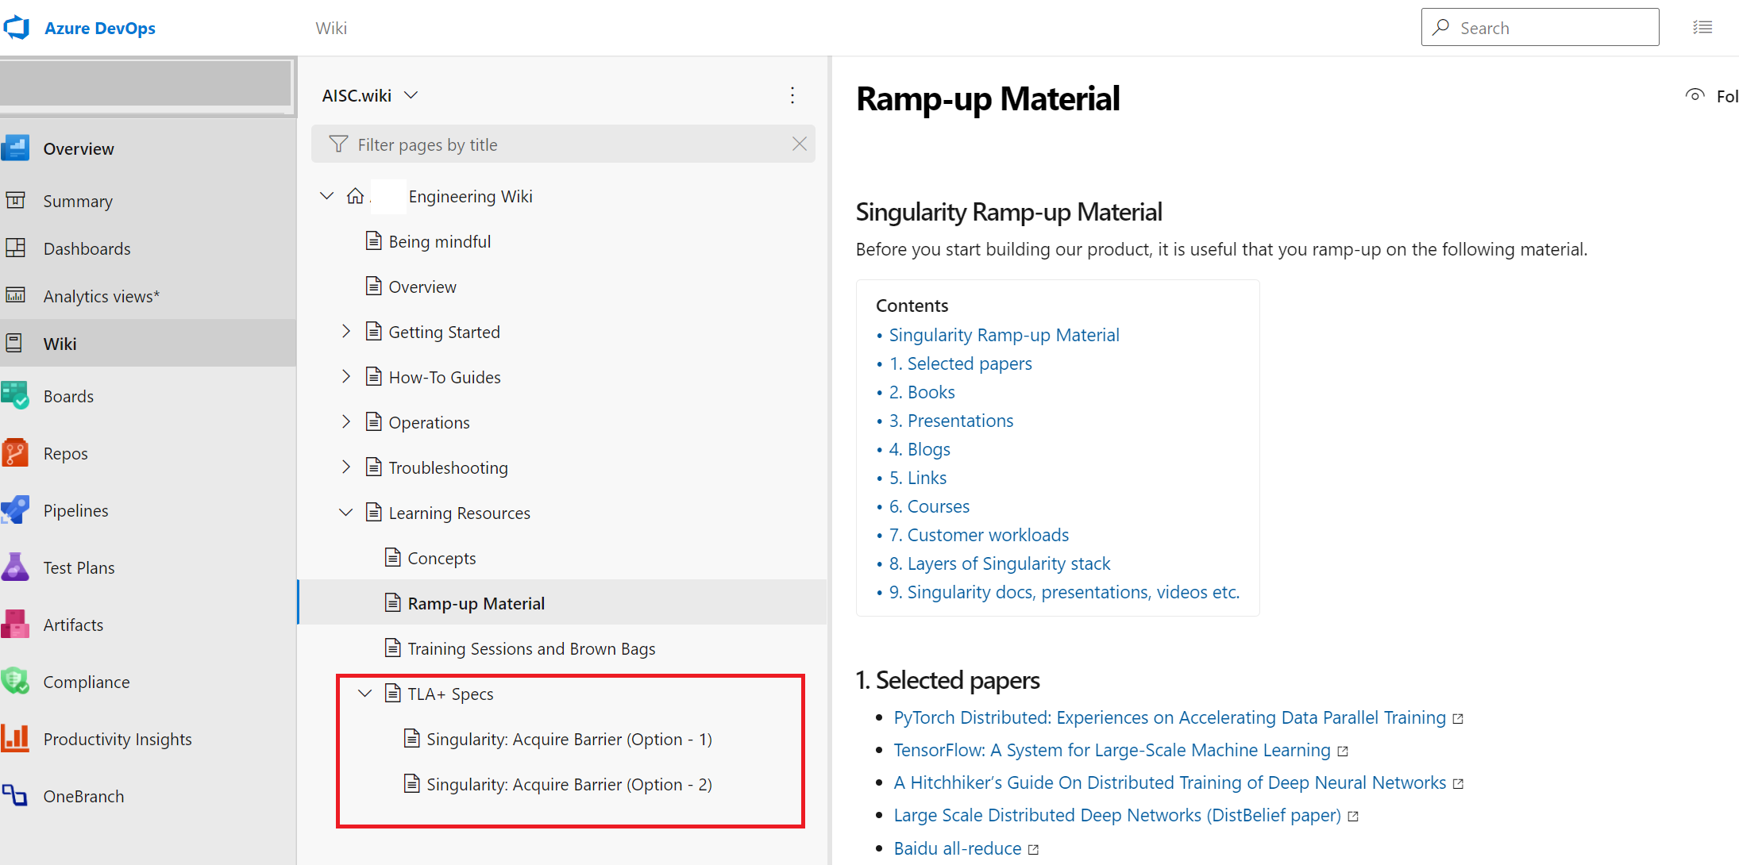
Integrating TLA+ as part of onboarding new engineers

Slide 14
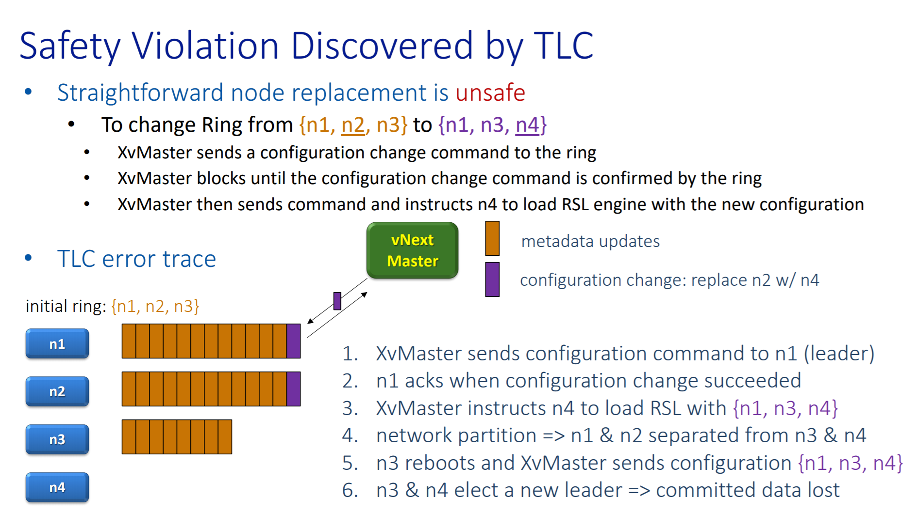
Accompanying postmortems of service outages with TLA+ specs

Slide 15
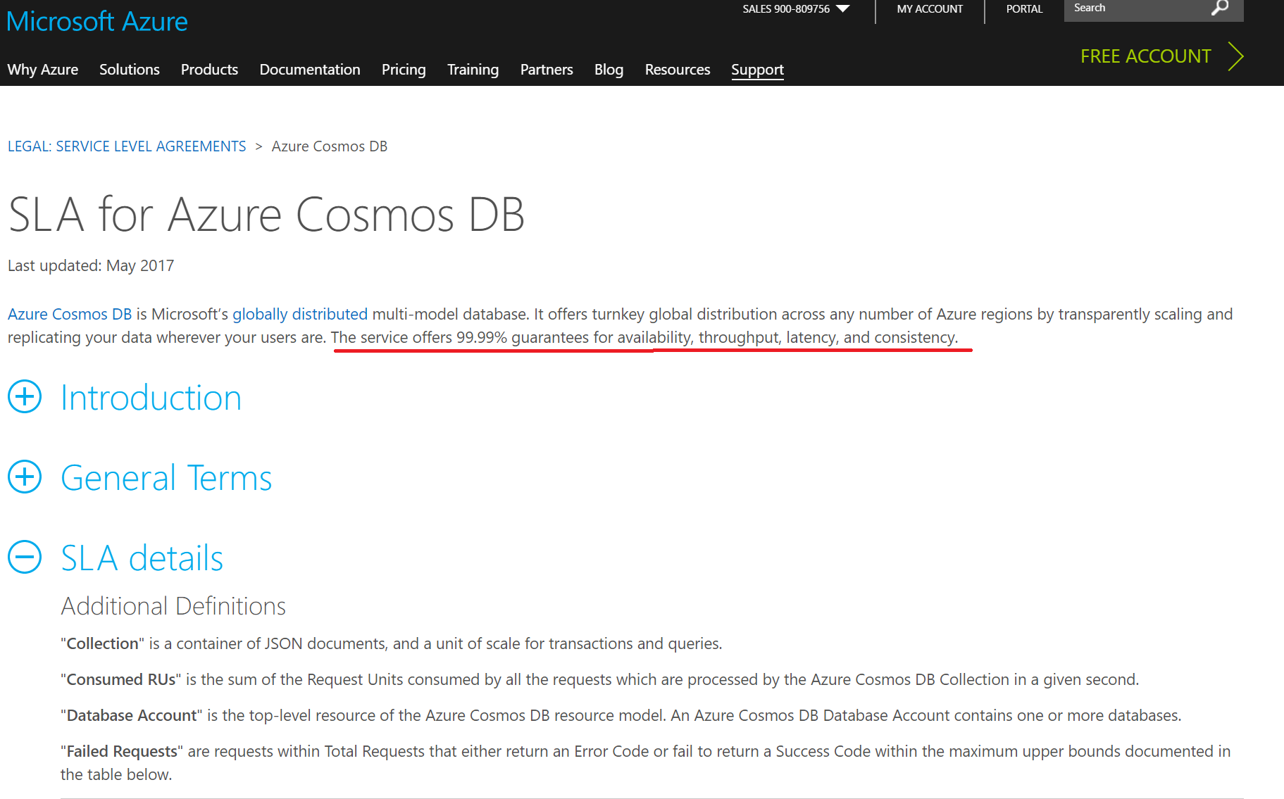
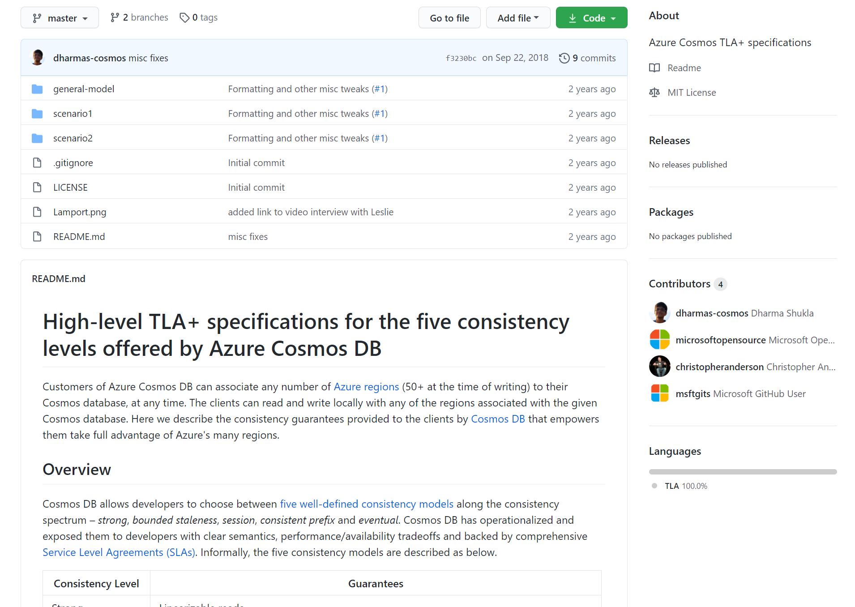
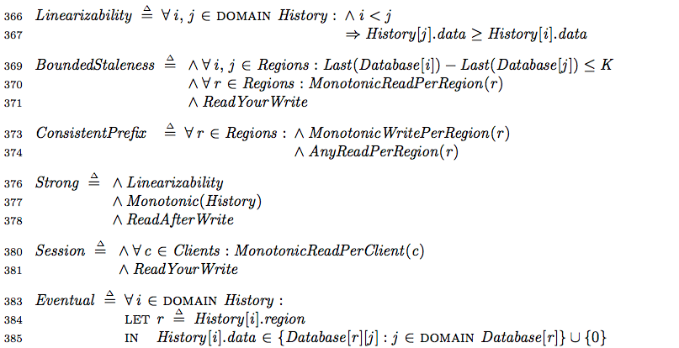
Accompanying SLAs with TLA+ specs

Slide 16
3. Conclusion

Slide 17
Conclusion
Model first and debug your design exhaustively before writing any code
Making model checking and TLA+ part of the engineering culture produces robust designs and enables engineers to precisely communicate their designs
TLA+ has been applied successfully in multiple large-scale systems at Microsoft

